Slide 1


SEWAGE PLANT ODOR MONITORING AND PREDICTION SYSTEM
Presented by: Team Blue Sky

Slide 2






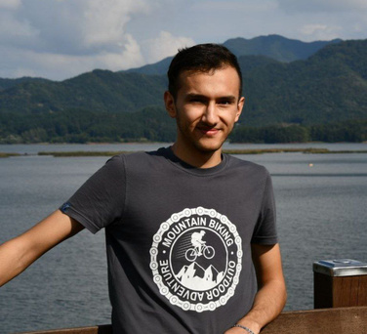

OUR TEAM
Victor Opaleke
An Si-Eun
Kasimov Azizjon
Min Woo Cho
Sukhrob
Ikromov
Model Performance
Project Researcher
Project Manager
Project Researcher
Data Scientist

Slide 3

OVERVIEW
01
02
03
Background
Project details
Development scope
04
05
06
Development process
System overview
System Architecture
07
08
09
Challenges
Development results
Completed tasks

Slide 4
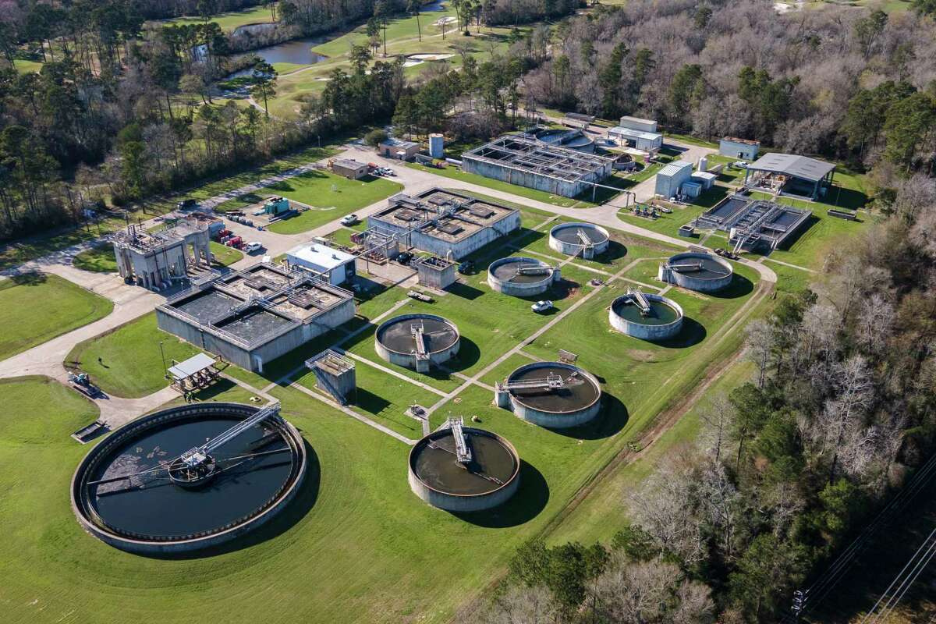
BACKGROUND
The odor emitted from a sewage treatment plant is an important environmental problem. Bad odors can lead to public complaints, health issues, and reduce the quality of life in nearby areas. An estimation of odor emission rate is difficult to detect and quantify. The evaluation of odor emission involves huge manpower, time, and cost.

Slide 5


PROJECT DETAILS
Sensor technology
Sensor technology is used to detect concentrations of NH3 (ammonia), H2S (hydrogen sulfide), total volatile organic compounds (TVOCs) and other odor-causing compounds.
Weather synchronization
Predict odor distribution patterns using weather variables such as temperature, humidity, wind direction, and speed.
Predictive Analytics
Use machine learning algorithms to analyze time series data to increase the accuracy of odor intensity prediction.

Slide 6
ORIGINAL SCOPE
DESIGN GOAL 1
Implement a model that enables the prediction of odor levels from some features of a given dataset
DESIGN GOAL 2
Visualize the predictions of models and report their performance.

Slide 7





DEVELOPMENT PROCESS
Data Preprocessing
Algorithms
Comparison
Normalize data, feature engineer, identify outliers and identify seasonality.
Implementing various prediction models.
Comparing and choosing the best performing prediction algorithm

Slide 8
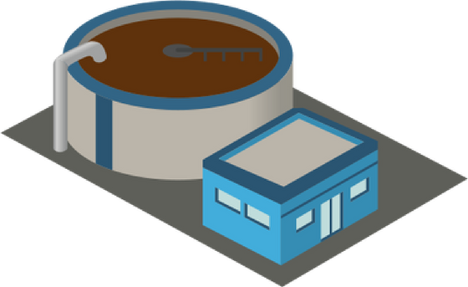




MODEL OPERATION
Sensory data from sewage plant
Prediction model
Visualization module
Anomaly notice

Slide 9


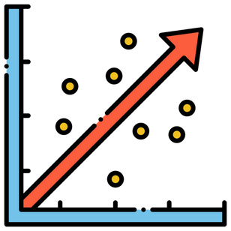



MODELS TESTED
Cone-shaped neural network
Linear
regression
Polynomial regression
LSTM
Extreme randomized trees regressor

Slide 10
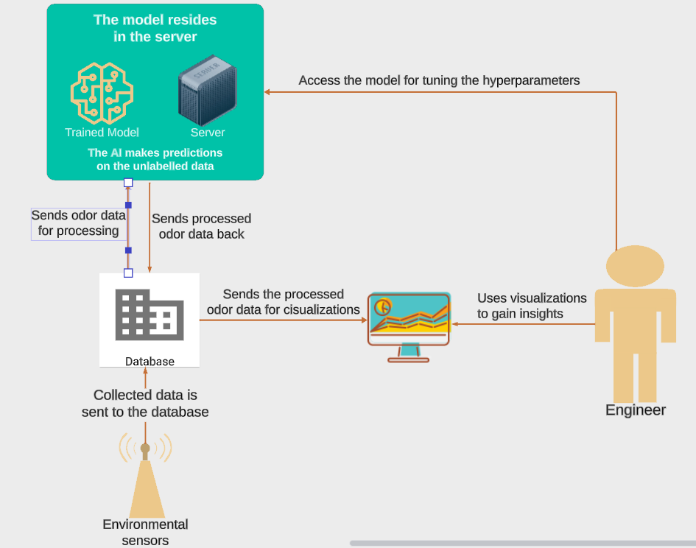
SYSTEM ARCHITECTURE DIAGRAM

Slide 11

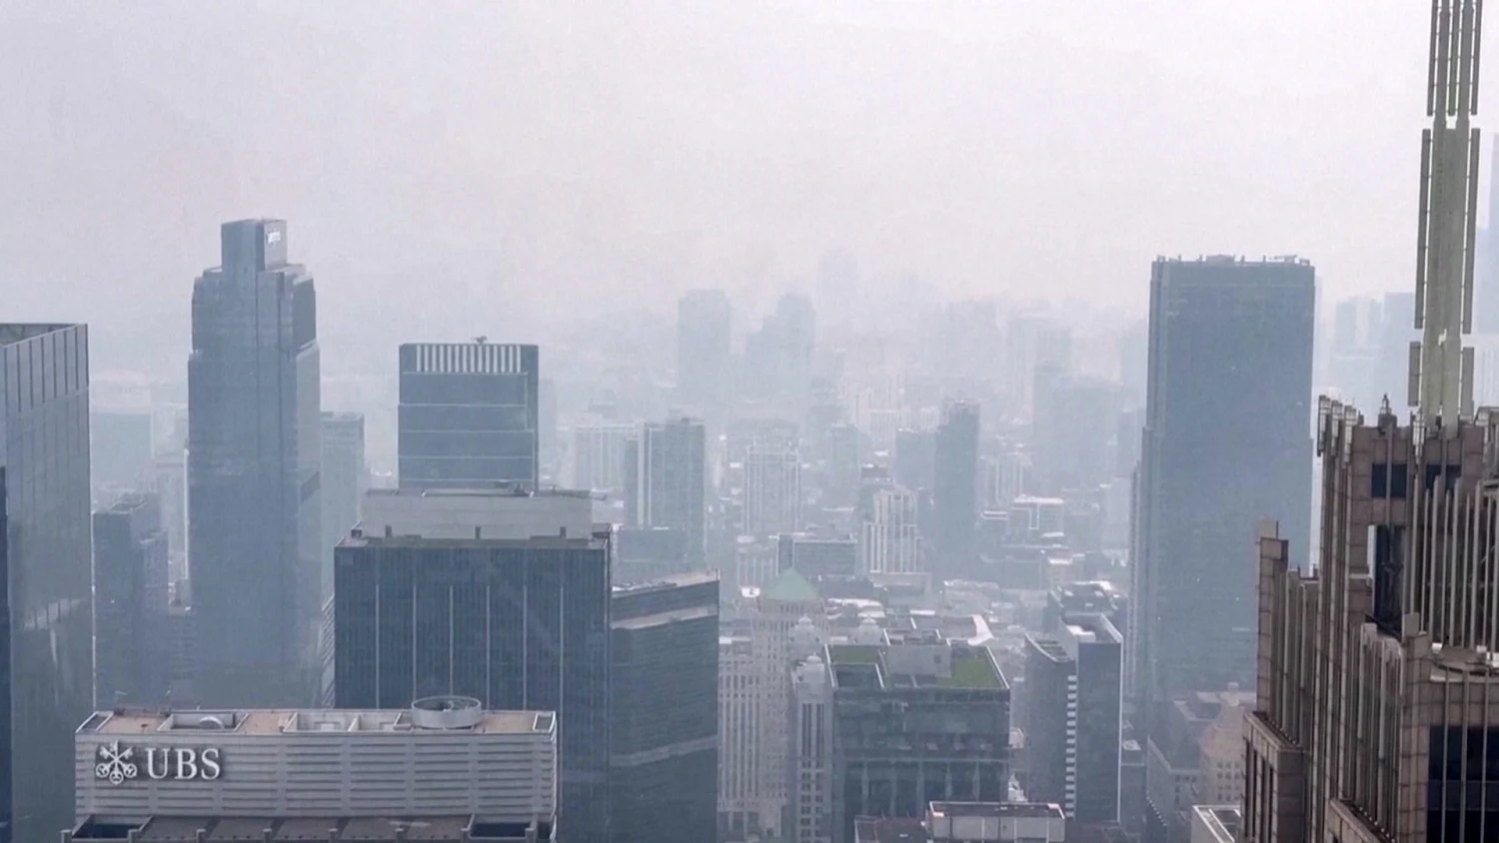
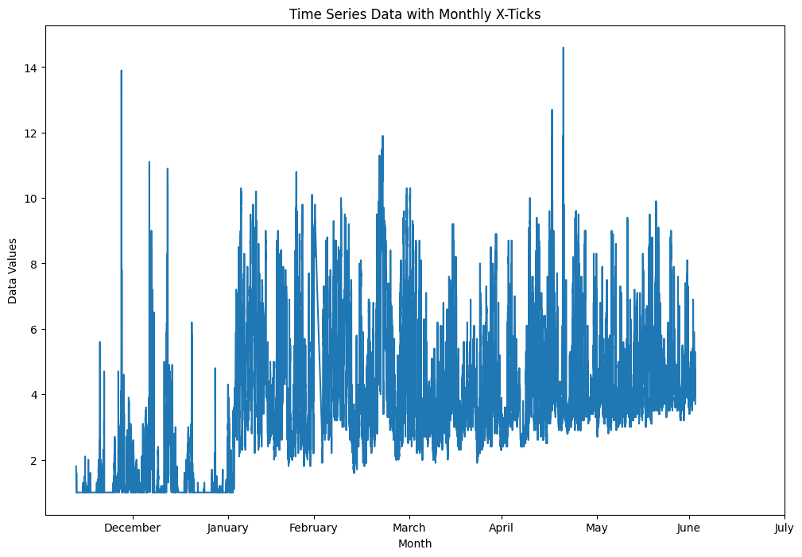
Implementation problem

Slide 12
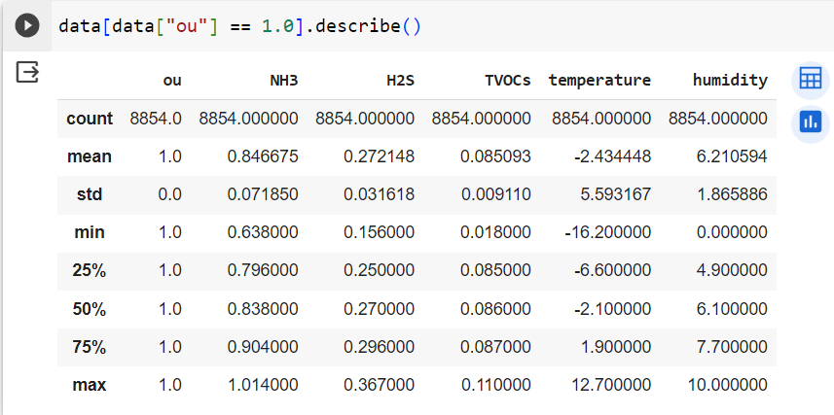
Implementation problem No. 2

Slide 13
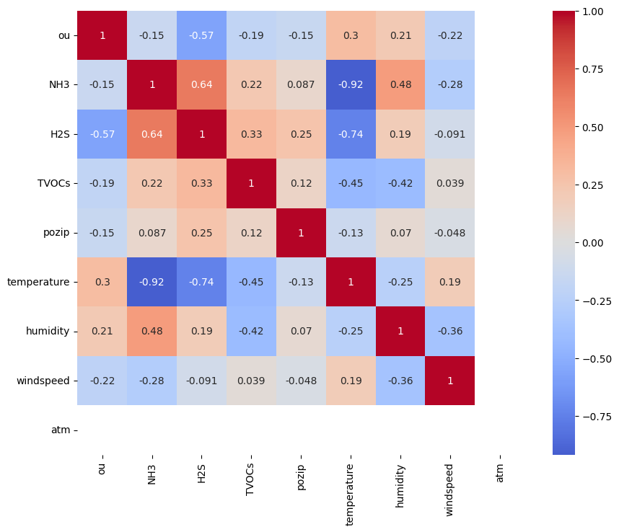
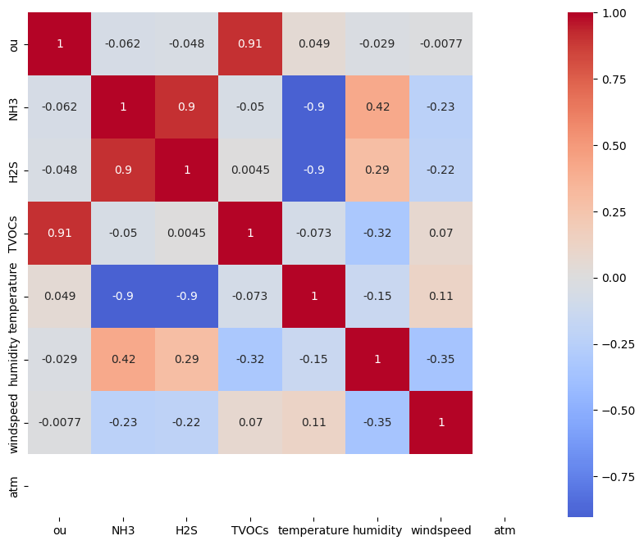
Data correlation
dataset 9
dataset 7

Slide 14
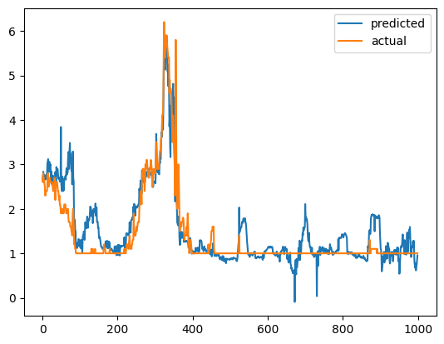
Implementation status
Sequence of 1.0 values
Polynomial regression.
R2 value: 0.8
MSE: 0.15

Slide 15
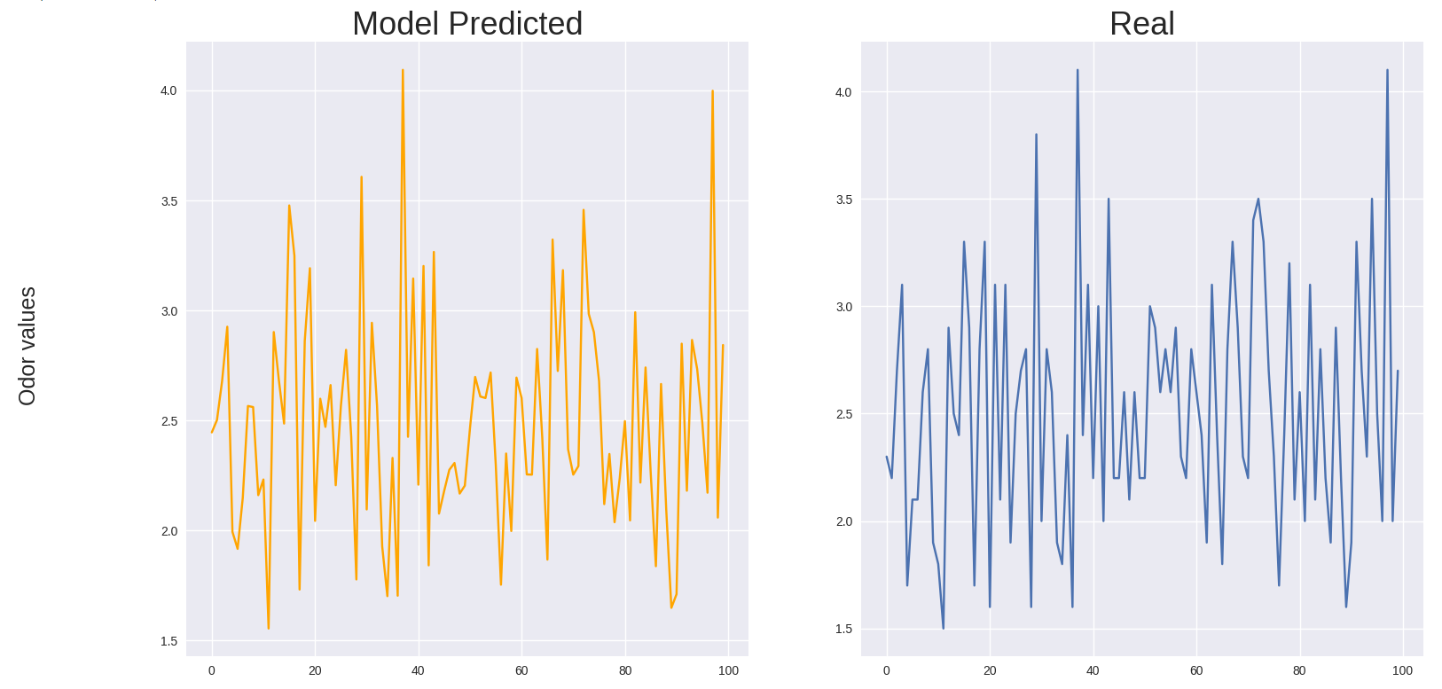
Development Result
Extra trees regressor model.
Prediction accuracy: 80%. Error value: 0.07

Slide 16
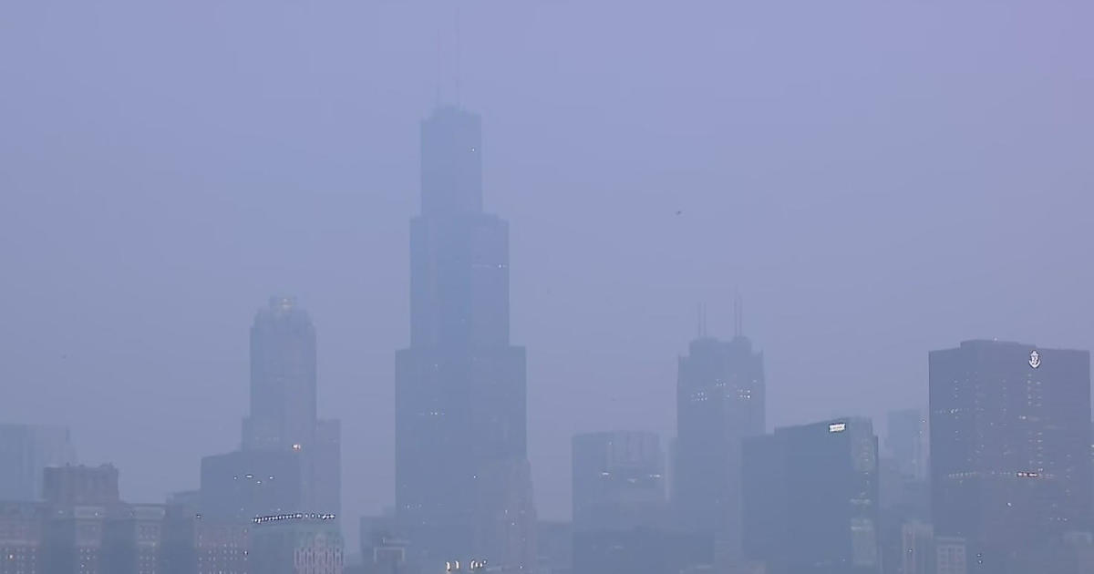

FACED CHALLENGES
STRUGGLING TO UNDERSTAND THE DATA
LACK OF DATA
The provided data was hard to interpret and understand given features that were not strongly correlated with the target variable
The labelled data had a period of less than a year, that created limitations to identify the seasonality
NO KNOWLEDGE ABOUT EQUIPMENT
Did not know the location and models of the sensors

Slide 17

COMPLETED TASKS
2. STUDIED SIMILAR PROJECTS
1. EXPLORED THE DATASET
3. PREPROCESING
We looked at studies done on the same problem worldwide. After studying them, we gained insights and proceeded our development.
Based on the papers, recommendations from mentor and general conventions we preprocessed the dataset
We implemented statistical methods to find data distribution and feature correlation
4. IMPLEMENTED PREDICTION ALGORITHMS
5. COMPARED PERFORMANCES
Based on the research papers and recomendations from mentor, we trained certain selection of algorithms
After training the models, we compared their performance and reported to our mentor.

Slide 18

Thank For Your Attention

